Slide 1
Data processing using Excel with R
Prepared by:
Andrew McLachlan

Slide 2

The research problem
The researchers were experimenting with different recipes for a “food bar” and were trying many different combinations of ingredients and ratios of the ingredients. They wanted to know how each bar recipe performed after time (up to several weeks) in storage.
The initial problem was how to load many data files into Excel
This evolved into creating macros for manipulating data, plotting graphs, and more complicated calculations, all within Excel

Slide 3
Food texture analysis
Purpose is to investigate the texture and structure of foods
Use controlled physical tests
Relate measurements to human sensory results
Simply measure force exerted on a food by a test rig, over time and distance

Slide 4
Examples: biscuit crunchiness

Slide 5
Three-point bend test

Slide 6
Margarine spreadability

Slide 7
Extrusion test

Slide 8
Example results

Slide 9
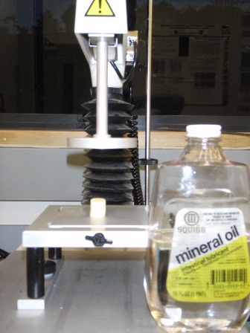
Compression test

Slide 10
Compression test (1)

Slide 11
Compression test (2)

Slide 12
Compression test (3)

Slide 13
Example compression results

Slide 14
Points of interest
Peak
Pseudo-fracture
“roll-over” point
Modulus of deformability

Slide 15
Points of interest
Peak
Pseudo-fracture point, or “roll-over” point
  (point of maximum reduction in angle of curve)
Modulus of deformation
  (point of maximum slope)
Points routinely identified manually by an “expert”
The researchers wanted a more objective method

Slide 16
Problem of “noise”
Some measurements (particularly from one machine) had “noise” in the data which caused problems with finding the points of interest, particularly the peaks.
Tried using moving averages:
For slope, use 3-point MA, then slope using 7 points
Worked well for slope because the region of interest was reasonably linear
For finding peaks a better smoothing method was needed

Slide 17
Lowess smoothing
Lowess (or Loess) smoothing stands for:
“LOcally WEighted regrESSion”
Fit a moving regression line (or quadratic). Points are weighted based on how far they are from the prediction point
Tri-cube weighting:
where d_{i}= distance to i^{th} point as a proportion of the maximum distance over the points used.

Slide 18
Effect of lowess smoothing

Slide 19
A small problem...
But, cannot easily perform lowess smoothing natively within Excel
So, use R via RExcel add-in

Slide 20
RExcel
Connects R and Excel
Can provide an Add-in menu to do analysis using R with data in Excel
Can provide further functions to use in Excel formulae
Can provide functions to use in Excel macro programming (VBA)
When programmed in a macro, the user does not need to see or know about R
Download from http://rcom.univie.ac.at/

Slide 21
Code
R code:
predict(loess(y~x,span=0.1,degree=2))
VBA code:
RInterface.StartRServer
RInterface.PutArray "x", rngX, False, False
RInterface.PutArray "y", rngY, False, False
RInterface.GetArray _ "predict(loess(y~x,span=0.1,degree=2))", _ rngSmooth
RInterface.StopRServer

Slide 22
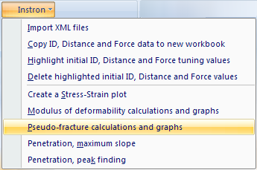
The results
Add-in menu
Resulting graph

Slide 23
Results

Slide 24
Acknowledgements
Allan Hardacre
Suzanne Clark
Julien Cornuel
Mathilde Leleux
Elodie Cluzel

Slide 25


The New Zealand Institute for Plant & Food Research Limited
www.plantandfood.com

